Slide 2
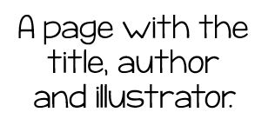
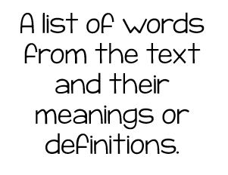
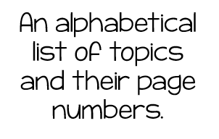
Notes:
Match the word and definition with the picture of the print features.

Slide 3
Notes:
Click in the gray boxes and type the answer.

Slide 4
Notes:
Match the word with the picture of the text features.

Slide 5
Notes:
Click in the gray boxes and type the answer.

Slide 6
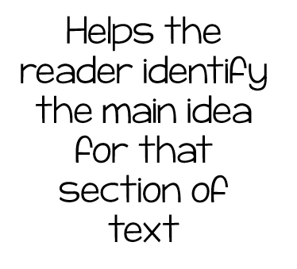
Notes:
Match the word and definition with the picture of the organization features.

Slide 7
Notes:
Click in the gray boxes and type the answer.

Slide 8
Notes:
Click in the gray boxes and type the answer.

Slide 9
Notes:
Match the word with the picture of the illustration type.

